Slide 1



Trusted sla-guided data integration on multi-cloud environments
Daniel Aguiar da Silva Carvalho, Magellan, IAE, Université Jean Moulin Lyon3
Chirine Ghedira Guegan, Magellan, IAE, Université Jean Moulin Lyon3
Genoveva Vargas-Solar, CNRS, LIG-LAFMIA, Saint Martin d'Hères - France
Nadia Benani, CNRS INSA-Lyon, LIRIS, UMR5205 - France

Slide 2
Data integration: existing work
Query
Result
Data integration: the teenage years. Halevy, A., Rajaraman, A., & Ordille, J. (VLDB 2006, September)
Schema integration: Past, present, and future (Ram, S., & Ramesh, V. 1999)
Global schema
Mediator
Query rewriting
Data integration architectures:
Multi-databases, federations, DW, …
(Domenig & Dittrich 1999 Sigmod Record)
MiniCon algorithm for query rewriting (Pottinger and Halevy, 2001)
Exported schemata
Data
source A
Data
source B
Data
source C
Heterogeneous data sources known in advance

Slide 3
Data integration: existing work
Services lookup and matching
[1] Paolucci, M., Kawamura, T., Payne, T. R., & Sycara, K. (2002, June). Semantic matching of web services capabilities. In International Semantic Web Conference (pp. 333-347). Springer Berlin Heidelberg.
[2} Bramantoro, A., Krishnaswamy, S., & Indrawan, M. (2005, November). A semantic distance measure for matching web services. In International Conference on Web Information Systems Engineering (pp. 217-226). Springer Berlin Heidelberg.
[3} APA Maximilien, E. M., & Singh, M. P. (2004, November). Toward autonomic web services trust and selection. In Proceedings of the 2nd international conference on Service oriented computing (pp. 212-221). ACM.
Query
Result
Mediator
Query rewriting techniques adapted to service composition
Exported API
[4] Barhamgi, M., Benslimane, D., and Medjahed, B. (2010). A query rewriting approach for web service composition. IEEE T. Services Computing, 3(3):206–222.
[5] da Costa, U. S., Alves, M. H. F., Musicante, M. A., and Robert, S. (2013). Automatic refinement of service compositions. In Daniel, F., Dolog, P., and Li, Q., editors, ICWE, volume 7977 of Lecture Notes in Com- puter Science, pages 400–407. Springer.
[6] Zhao, W., Liu, C., and Chen, J. (2011). Automatic composition of information-providing web services based on query rewriting. Science China Information Sciences, pages 1–17.
. . .
Distributed data services

Slide 4
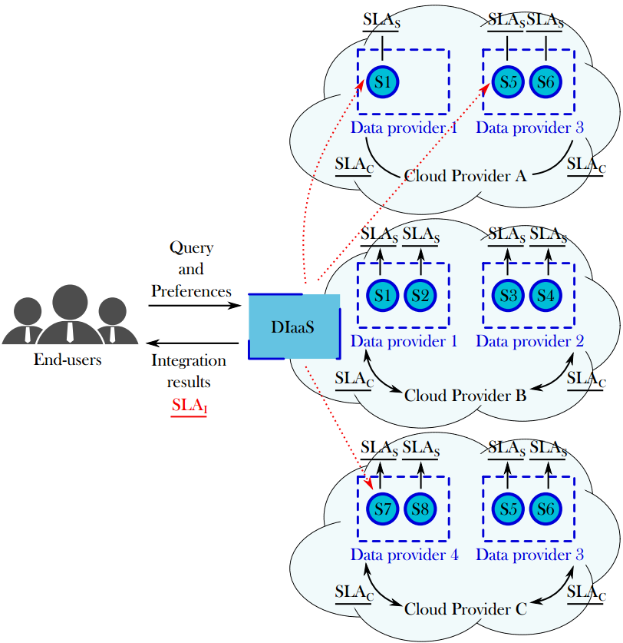
Context
Challenges:
Which services should I select ? Are the requirements being respected?
How to be sure that all SLAs are being respected?
How to integrate different SLAs associated to services involved with user’s requirements?
How results can be reused for a next query?
Objective:
To propose a data integration solution in a multi-cloud environment guided by user requirements and SLA exported by different clouds.

Slide 5
Contributions
Systematic mapping methodology to build the corpus of the state of the art and to identify new trends and open issues around our research topic.
Database | Amount | Included | Excluded
IEEE | 658 | 56 | 602
ACM | 649 | 31 | 618
Science Direct | 106 | 6 | 100
CiteSeerX | 419 | 21 | 398
Total | 1832 | 114 | 1718
D. A. S. Carvalho, P. A. Souza Neto, G. Vargas-Solar, N. Bennani, C. Ghedira, Can Data Integration Quality be Enhanced on Multi-cloud using SLA?, In 26th Int. Conf. on Database and Expert Systems Applications, Spain, 2015.

Slide 6
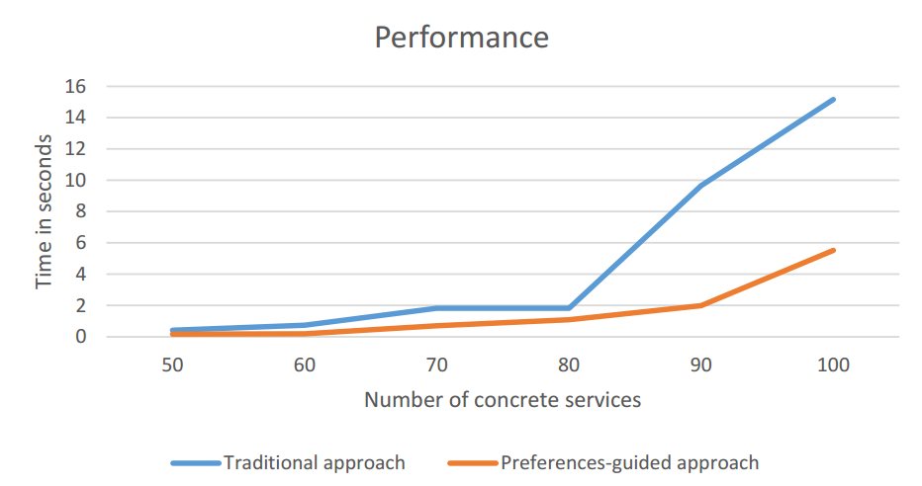
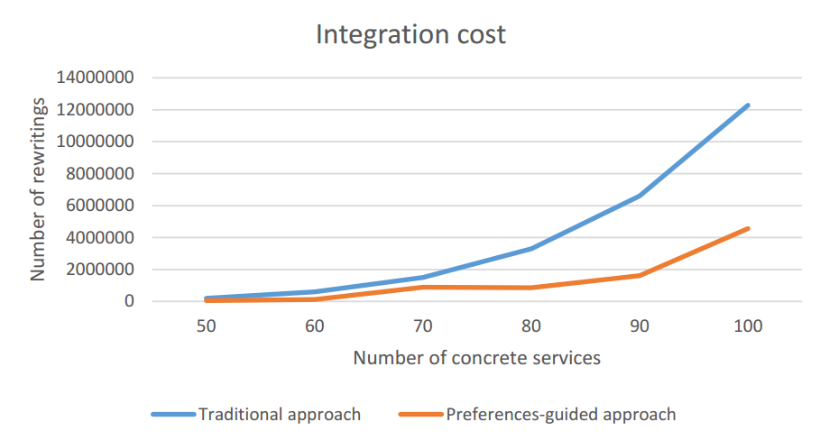
contributions
Design and implementation of the Rhone query rewriting algorithm for data integration which takes into consideration user integration preferences and services’ quality aspects expressed in SLAs.
D. A. S. Carvalho, P. A. S. Neto, C. Ghedira, G. Vargas-Solar, N. Bennani. Rhone: a quality-based query rewriting algorithm for data integration. East-European Conference on Advances in Databases and Information Systems, Aug 2016, Prague, France. ADBIS East-European Conference on Advances in Databases and Information Systems, 2016.

Slide 7
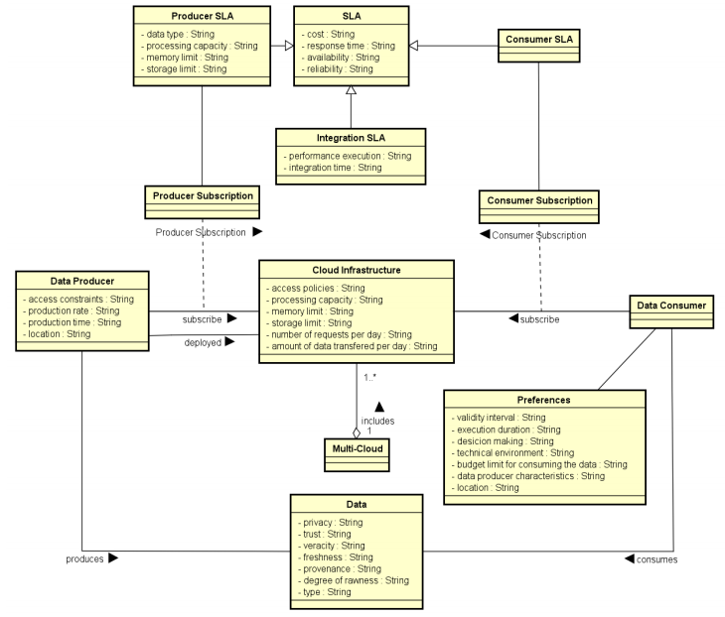

contribution
Design of a metamodel, a metaprocess and process for data integration adapted to the multi-cloud context.
D. A. S. Carvalho, P. A. S. Neto, C. Ghedira, G. Vargas-Solar, N. Bennani. Towards Quality Guided Data Integration on Multi-Cloud Settings. 14th international conference on service oriented computing (ICSOC), Oct 2016, Banff, Alberta, Canada.

Slide 8
contribution
Proposal of the schemes for cloud SLA, service SLA and integration SLA.
Ongoing work:
Definition and formalization of the incomming queries variations and their integration reusability solution.
Heuristics for optmizing the rewriting approach adapted to the multi-cloud context.

Slide 9
Future work
Refinement of the SLA schemas
Apply and evaluate the heuristics to the rewriting approach
Design of a architecture which allows data providers to manipulate and configure the necessary resources to their services
Evaluation of the overall data integration approach adapted to the multi-cloud context

